Slide 1
The Power of Data

Slide 2

How Powerful is Data ?

Slide 3
What do we have ?
Considering Income data of 32561 adults, with the following variables
Income, above or below $50000
Sex
Marital Status
Level of Education

Slide 4
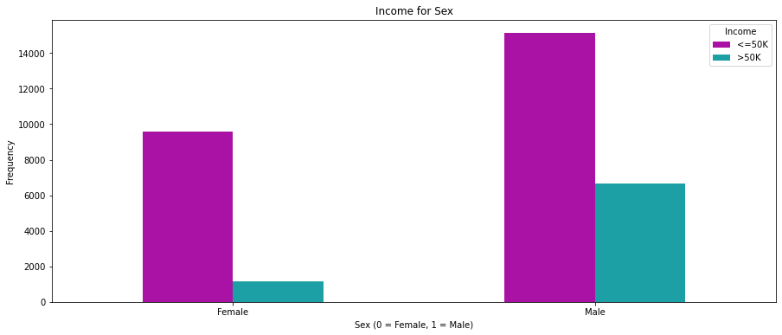
Who is EARNS more ? Male or Female

Slide 5
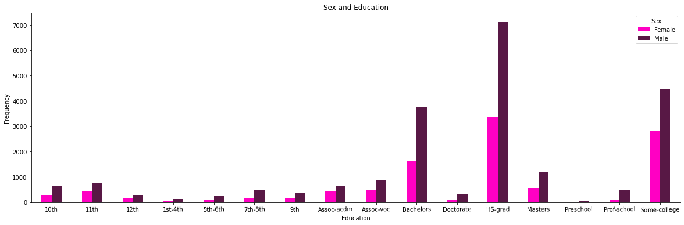
Who is more Educated ? Male or Female

Slide 6
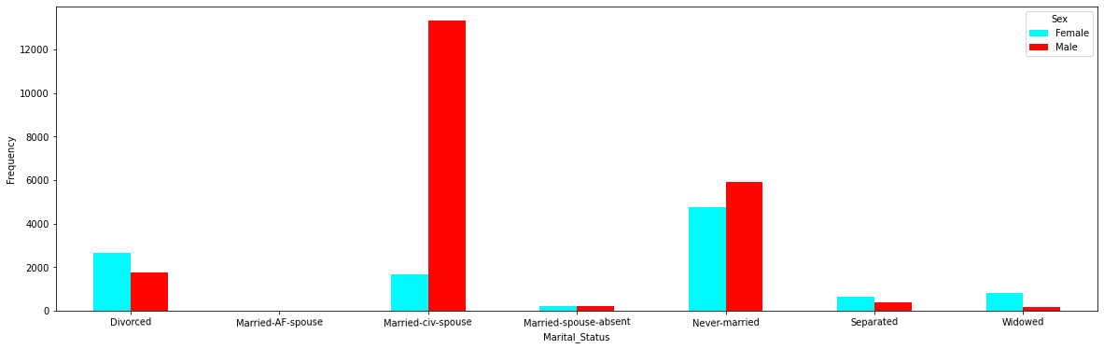
Marital Status

Slide 7
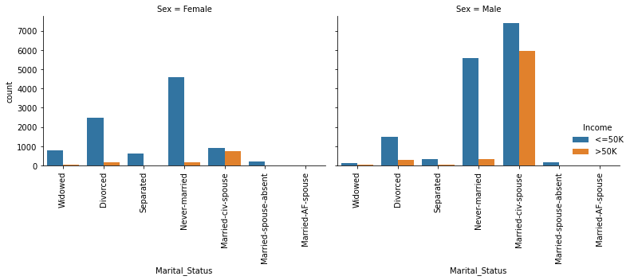
Income of the Marital Status

Slide 8
What does this means?
Males are more educated than Females
Males earn more
Divorced females are more educated than divorced males
Divorced females earn less $50000

Slide 9
It depends on the data
How true are these conclusion ?

Slide 10
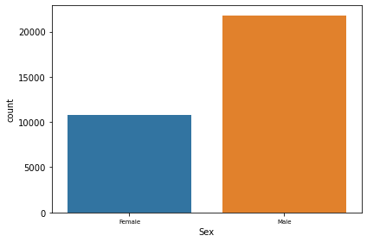
What does the data says ?
If the number of males are twice the number of female then we should expect these results
So skewed data give skewed results

